Slide 1

6th Grade Math
Unit 7, Lesson 5 Adding Integers Volume 2, pg. 24

Slide 2


Benchmark
MA.6.NSO.4.1
Apply and extend previous understandings of operations with whole numbers to add and subtract integers with procedural fluency.
volume 2, pg. 24

Slide 3
Integrated Mathematical Thinking and Reasoning Standards
MA.K12.MTR.3.1 Complete tasks with mathematical fluency.
MA.K12.MTR.4.1 Engage in discussions that reflect on the mathematical thinking of self and others.
volume 2, pg. 24

Slide 4

Learning Target
I can add integers with procedural fluency.
volume 2, pg. 24

Slide 5

Warm-Up
volume 2, pg. 25

Slide 6
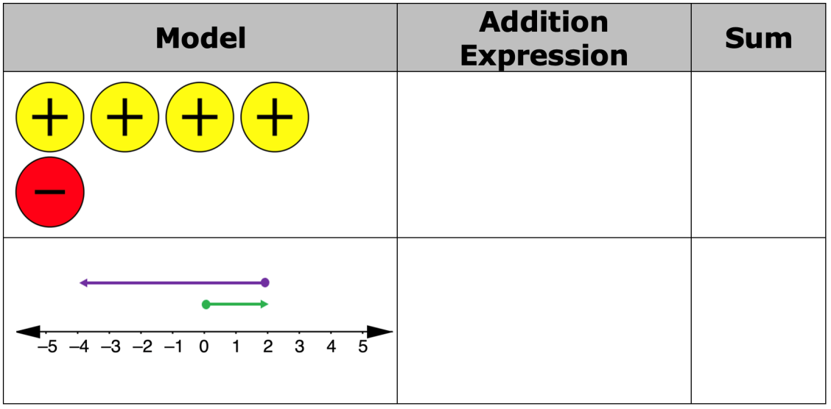
7.5.1 Warm-Up: Representing Addition
Write the addition expression represented by the model. Then, find the sum.
volume 2, pg. 25

Slide 7

Exploration
volume 2, pg. 25

Slide 8

7.5.2 Exploration: Additive Inverses
Use the number line to show the sum of $−4+4$. Then, complete the equation.
$$−4+4=_________$$
Represent the sum of $−4+4$ using integer chips.
volume 2, pg. 25

Slide 9

Use the number line to show the sum of $7+(−7)$. Then, complete the equation.
$$7+\left(−7\right) =_________$$
Represent the sum of $7+(−7)$ using integer chips.
volume 2, pg. 25

Slide 10

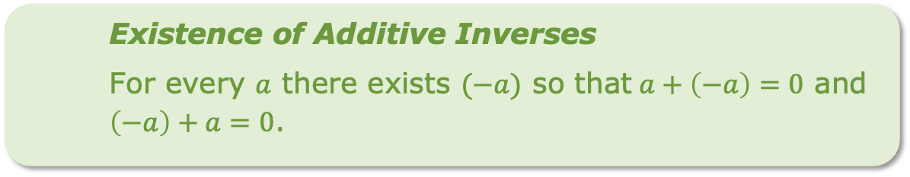
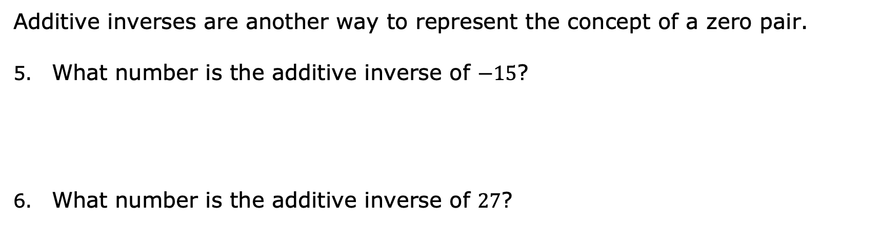
Existence of Additive Inverses
For every $a$ there exists $(−a)$ so that$a+\left(−a\right)=0$ and $\left(−a\right)+a=0$.
Additive inverses are another way to represent the concept of a zero pair.
What number is the additive inverse of $−15$?
What number is the additive inverse of $27$?
volume 2, pg. 26

Slide 11
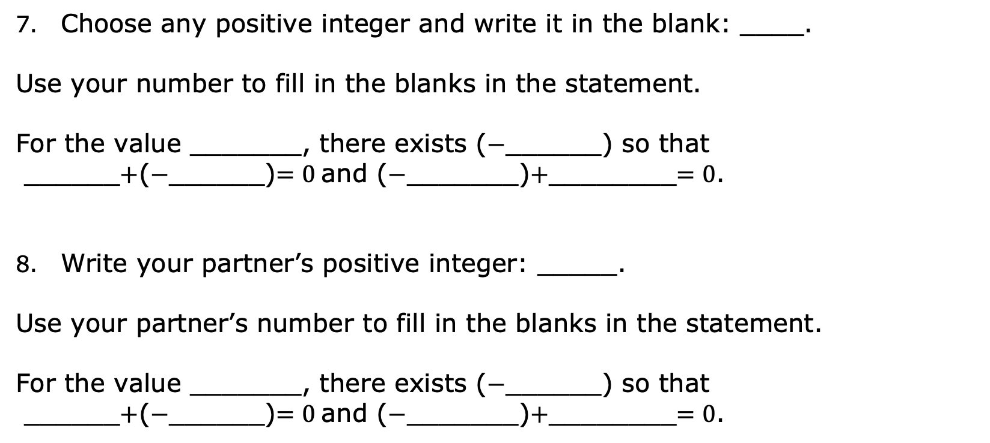
Choose any positive integer and write it in the blank: ____.
Use your number to fill in the blanks in the statement.
For the value _______, there exists ($−$______) so that
______$+$($−$______)$=0$and ($−$_______)$+$________$=0$.
Write your partner’s positive integer: _____.
Use your partner’s number to fill in the blanks in the statement.
For the value _______, there exists ($−$______) so that
______$+$($−$______)$=0$and ($−$_______)$+$________$=0$.
volume 2, pg. 26

Slide 12

Guided Instruction
volume 2, pg. 26

Slide 13

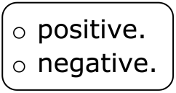
7.5.3 Guided Instruction: Adding Integers
Understanding the existence of additive inverses can be helpful when adding integers with larger absolute values.
Complete each statement based on your understanding of adding integers so far.
When adding two positive integers, the sum is
When adding two negative integers, the sum is
volume 2, pg. 26

Slide 14
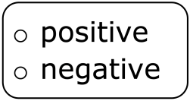
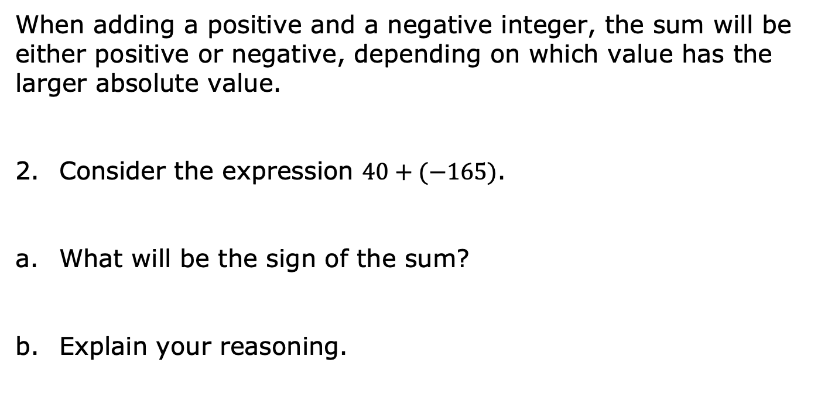
When adding a positive and a negative integer, the sum will be either positive or negative, depending on which value has the larger absolute value.
Consider the expression $40+(−165)$.
What will be the sign of the sum?
Explain your reasoning.
volume 2, pg. 26

Slide 15
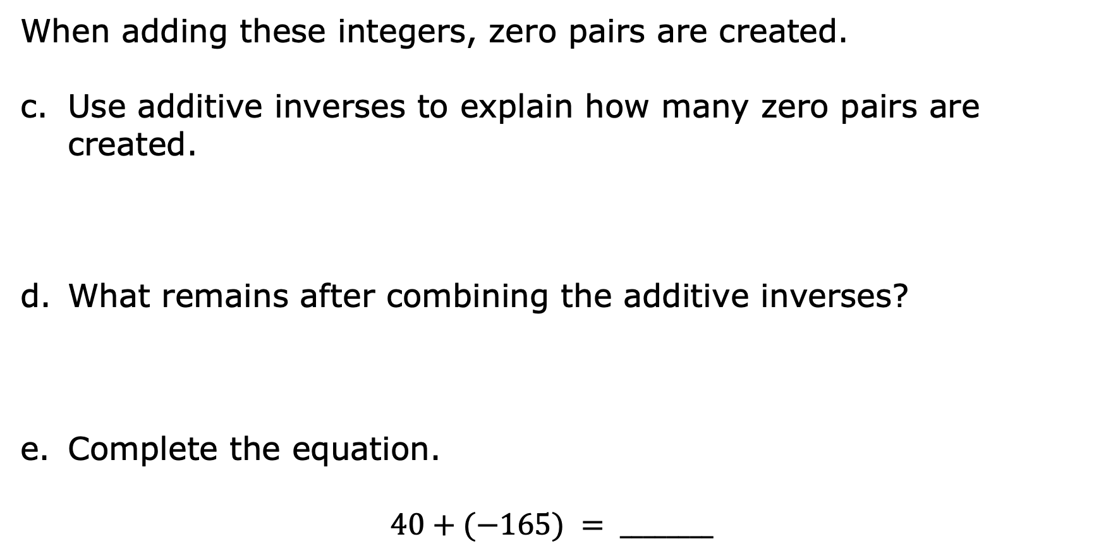
When adding these integers, zero pairs are created.
Use additive inverses to explain how many zero pairs are created.
What remains after combining the additive inverses?
Complete the equation.
$$40+(−165) = ________$$
volume 2, pg. 27

Slide 16
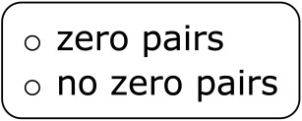
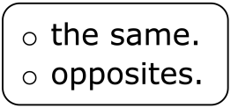
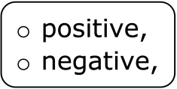
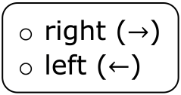
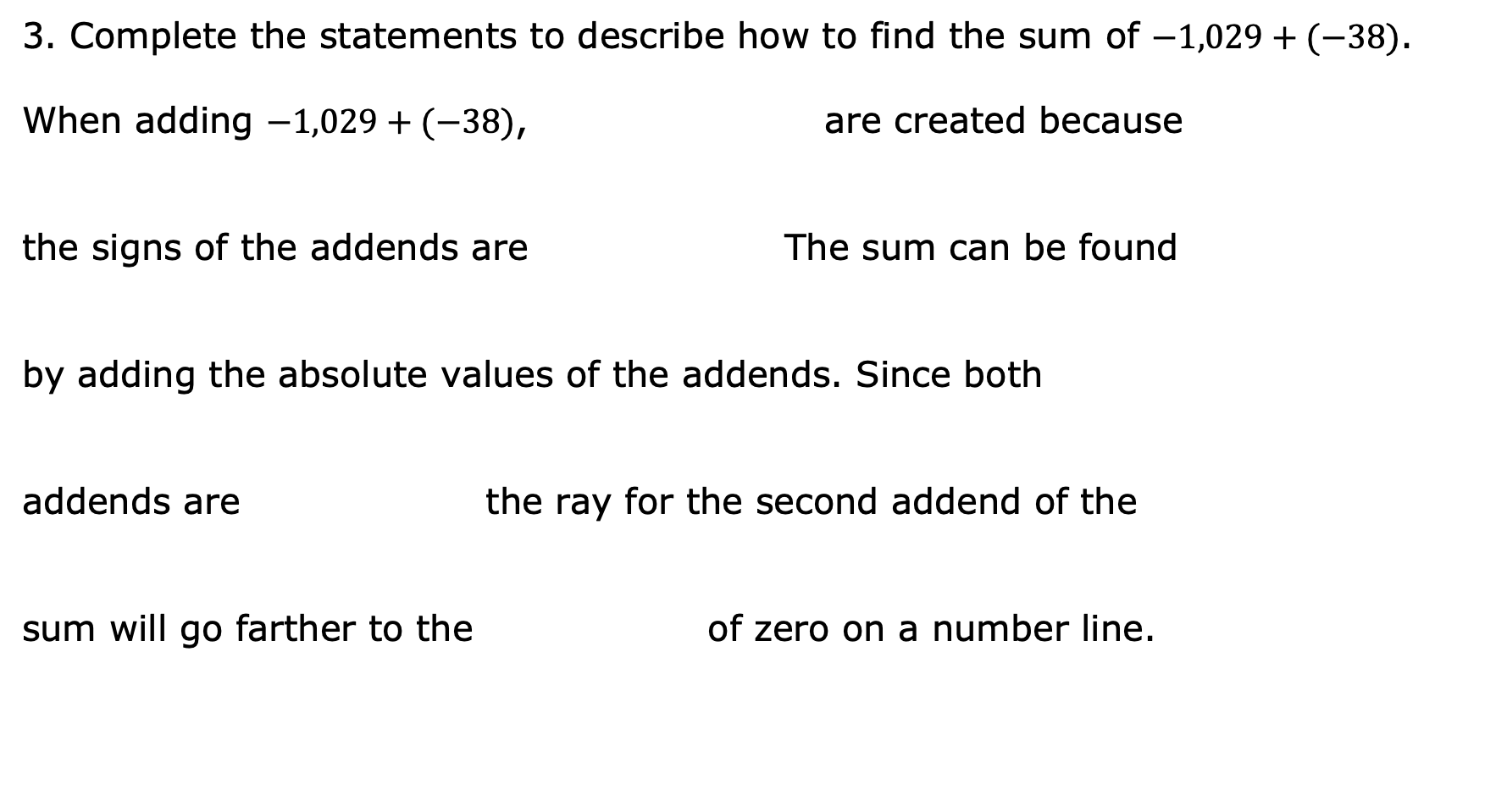
Complete the statements to describe how to find the sum of $−1,029+(−38)$.
When adding $−1,029+(−38)$, are created because
the signs of the addends are The sum can be found
by adding the absolute values of the addends. Since both
addends are the ray for the second addend of the
sum will go farther to the of zero on a number line.
volume 2, pg. 27

Slide 17
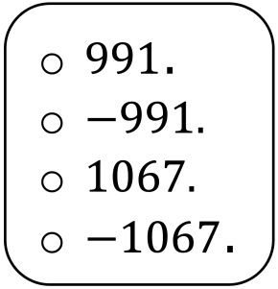
The sum of $−1,029+({}_{}^{−}{38})$ is
volume 2, pg. 27

Slide 18

Try It
volume 2, pg. 27

Slide 19


7.5.4 Try It: Adding Integers
Find each sum.
$−119+99$ b. $254+(−610)$
c. $−853+(−505)$ d. $−117+110$
volume 2, pg. 27

Slide 20

Collaboration
volume 2, pg. 28

Slide 21

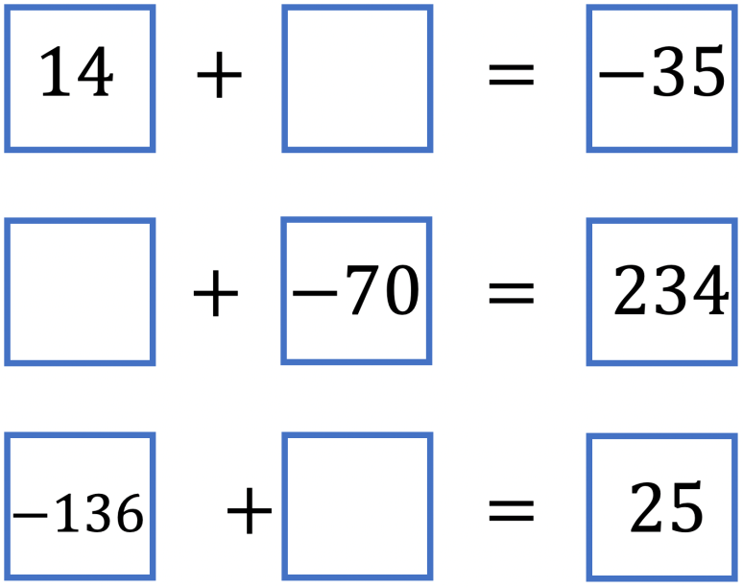
7.5.5 Collaboration: Reasoning with Integers
Work with your partner to fill in the blanks with an integer to make each equation true.
volume 2, pg. 28

Slide 22
Choose one equation and explain your thinking in determining the missing value.
volume 2, pg. 28

Slide 23

Your Turn
volume 2, pg. 28

Slide 24

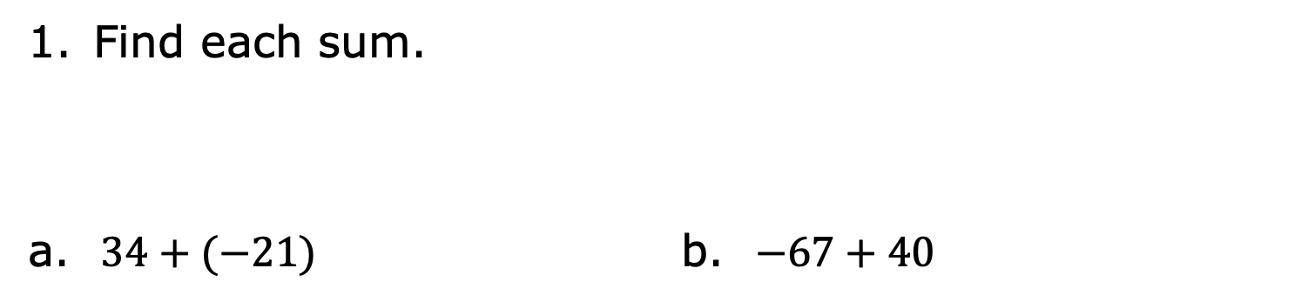
7.5.6 Your Turn!
Find each sum.
a. $34+(−21)$ b. $−67+40$
volume 2, pg. 28

Slide 25
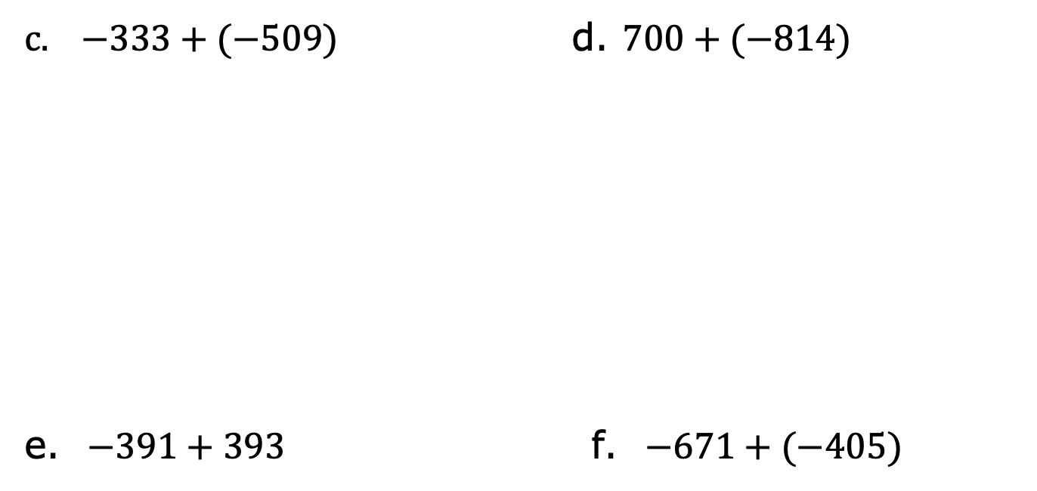
$−333+(−509)$ d. $700+(−814)$
e. $−391+393$ f. $−671+(−405)$
volume 2, pg. 28

Slide 26

Wrap-Up
volume 2, pg. 29

Slide 27
7.5.7 Wrap-Up: Growth Mindset
Today, I am still unsure about ____________________
____________________________________________.
To fill in this gap, I intend to _____________________
____________________________________________.
volume 2, pg. 29

